Slide 1
5S

Slide 2

Other Modules In This Series:
5S
Standard Work
Total Productive Maintenance (TPM)
Administrative Lean
Cell Design/ Production Preparation Process (3P)
Kaizen
Kanban
Problem Solving
Poka Yoke Quality Systems
Transaction Process Improvement (TPI)
Cause & Effect Diagram with the Additions of Cards (CEDAC)
Single Minute Exchange of Dies (SMED)
Value Stream Mapping (VSMi®)
Visual Management
Managing Daily Process Excellence
For More Information Please Contact:
Mark DeLuzio, President and CEO
+1.860.234.0915
mark.deluzio@leanhorizons.com
Strategically Creating Value Through the Elimination of Waste

Slide 3
This document contains confidential
and proprietary information owned
by Lean Horizons Consulting, LLC.
Any disclosure, use, copying or
distribution of this information without the express written consent of Lean Horizons Consulting is strictly prohibited.

Slide 4
Ground Rules for Event
Safety first (use personal protective equipment)
Active participation by all
Start and end on time
All electronic gadgets (phones, pagers, etc) turned to “off” or “silent”
Computers to be used only when instructed
Keep an open mind to change
Don’t let “perfect” get in the way of “better”
Notes:
DO: Perform Group Introductions. Pick an ice-breaker or exercise to warm the team up to the event. (Icebreaker Example: Everyone uses their name tent and writes a “Personal License Plate” in which they have 2 minutes to creatively use a total of 7 letters or numbers to tell us something about themselves. Examples “LV2SAIL” OR “DADOV5”
DO: Review Event Ground Rules.
ASK: “Does anyone have any rules they would like to see added?”
ASK: “Does everyone agree to these?”

Slide 5
Goal of 5S Module
To define 5S and apply the 5S process to achieve a target goal for your business as well as implement a process to sustain event results.
5S
Definition
5S
Process
5S
Review
Notes:
DO: Introduce the notion of 5S and the goal of this event.
At this time it is appropriate for the Process Owner or the Kaizen Team Leader to review the kaizen charter and objectives of the event.

Slide 6
5S
5S Definition
5S Process
5S Review
Objectives:
Define the goal of the 5S process
Define 5S
Identify purpose and benefits of 5S
Identify and define the steps of the 5S process
Discuss the impact of 5S in your work area
Review the 5S Event Charter
Notes:
DO: Review section objectives on slide.

Slide 7
Goal of 5S
5S Definition
Benefits of 5S Culture
The goal of 5S is to create
workplace organization,
improve productivity,
enable visual management, and lay the foundation for all other lean tools.
Safety
  Reduce the number of lost time accidents, workman’s compensation claims and
  OSHA recordables
Quality
  Eliminate the possibility of using previously rejected parts or the wrong tools. Eliminate contamination and assure compliance to
  standard procedures
Productivity
  Eliminate wasted time looking for tools. Reduce cycle time, reduce equipment downtime through regular cleaning and inspection

Slide 8
What is 5S?
5S Definition
Is about sustained workplace organization and discipline |  | Is not about “spring cleaning”
Is a tool that benefits the entire organization |  | Is not a “shop-floor only” tool
Is a continuous process and an on-going management tool |  | Is not a one-time event
Is for everyone |  | Is not “someone else’s” responsibility
Is a basic foundation for all other improvement |  | Is not optional

Slide 9
5S – Original Japanese Terminology
5S Definition
5S Descriptions
1S
Seiri
(整理)
Tidiness, organization
Refers to the practice of sorting through everything in the work area and keeping only essential items. Everything else is stored or discarded. This leads to fewer hazards and less clutter to interfere with productive work.
2S
Seiton
(整頓)
Orderliness
Focuses on need for an orderly workplace. Information, equipment, and materials must be systematically arranged for the easiest and most efficient access. There must be a place for everything and everything must be in its place.
Notes:
Add phonetic spelling for each Japanese word
Seiri = Sear-e
Seiton = Say-ton

Slide 10
5S – Original Japanese Terminology, Continued
5S Definition
5S Descriptions
3S
Seiso
(清掃)
Systemized Cleanliness
Indicates the need to keep the workplace clean as well as neat. Cleaning in Japanese companies is a daily activity. At the end of each shift the work area is cleaned up and everything restored to its place.
4S
Seiketsu
(清潔)
Standards
Allows for control and consistency. Basic housekeeping standards apply everywhere in the facility. Everyone knows exactly what his or her responsibilities are. Housekeeping duties are part of regular work routines.
5S
Shitsuke
(躾)
Sustaining discipline
Refers to maintaining standards and keeping the facility in safe and efficient order day after day, year after year.
Notes:
Add phonetic spelling for each Japanese word
Seiso = Say-zoo
Seiketsu = Say-kat-zoo
Shitsuke = Sheet-Soo-key

Slide 11
5S – English Translations
5S Definition
5S | English | Description
1S | Sort | Define what is necessary and unnecessary
2S | Straighten | A place for everything and everything in its place
3S | Scrub | Thoroughly clean the area and identify the sources of uncleanliness
4S | Stabilize | Execute process to maintain/improve the standards of the first 3 S’s
5S | Sustain | A sustained, disciplined 5S culture in the workplace

Slide 12
How does 5S relate to other lean best practices?
5S Definition
SMED
5S requires the clearing out of things which are not needed to make it easier to obtain the needed tools and parts. This is the foundation of Single Minute Change of Dies (SMED)
TPM
The first step of Total Productive Maintenance (TPM) is operator clean-up of machines.
Standard Work
5S supports having a waste-free, repeatable, sustainable process. In order to implement Standard Work in any area, completing 5S is essential.
Visual Management
The application of the first 3S’s enables the 4th ‘S’, Standardize. In the step, Visual Management is put in place in order stabilize the process and enable detecting normal from abnormal conditions.

Slide 13
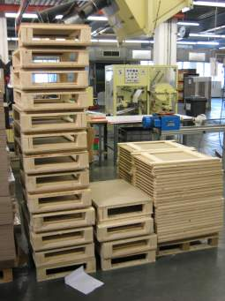
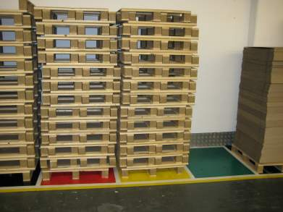
Examples of 5S
5S Definition
Before
After

Slide 14
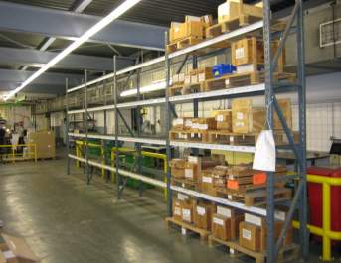
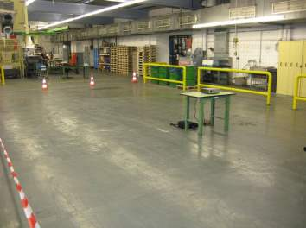
Examples of 5S
5S Definition
Before
After

Slide 15
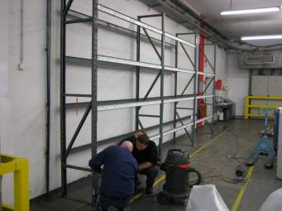
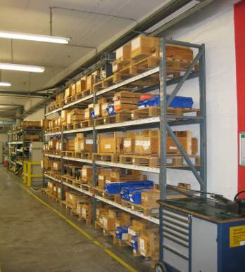
Examples of 5S
5S Definition
Before
After

Slide 16
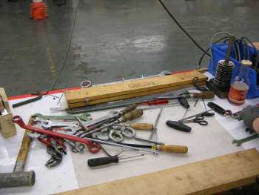
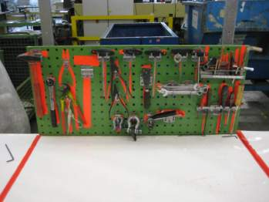
Examples of 5S
5S Definition
Before
After

Slide 17
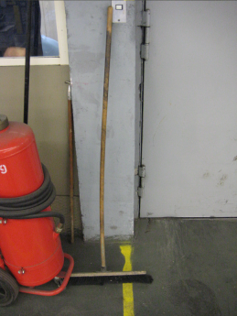
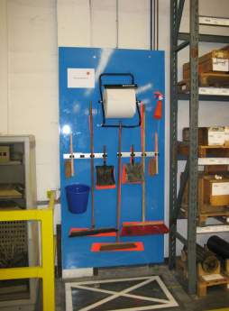
Examples of 5S
5S Definition
Before
After

Slide 18
5S Implementation Roadmap
5S Definition
5S Event
PROCESS STEP 1
PROCESS STEP 2
PROCESS STEP 3
PROCESS STEP 4
PROCESS STEP 5
Complete
5S Event
Pre-Work
Capture “Before Event” Data
Execute
5S Process
Document
Results
Achieve
5S Culture
Complete event charter & preparation
Review pre-work and event charter with team
Photograph areas
Measure virtual and physical space
Identify waste
Implement 1S
Implement 2S
Implement 3S
Develop tools
to stabilize and maintain results
Photograph areas
Measure virtual
& physical space
Quantify waste reduction
Implement 4S tools
Sustain results
Develop habits
Improve processes
Implement for entire business
5S has been quoted as the most important of all lean tools
Notes:
SAY: “The 5S Process is VERY Prescriptive! It is very important to implement them in the order defined. 5S Culture is a mindset and habit developed through DISCIPLINE, perseverance and commitment and includes continuous improvement of the process itself. 5S require a s MINIMUM of six months, even years achieve and is a foundational item that instills the disciplines required to achieve any of the benefits from the implementation of TPS.”

Slide 19
Exercise: 5S Discussion
5S Definition
Objective
Discuss the impact of 5S in your work area.
Instructions
Time to Complete
In small groups, discuss the issues you have seen in your work environment as a result of a lack of 5S. What wastes were caused?
What personal advantages do you see to working in a 5S culture?
Table answers on a chart paper.
10 minutes
Deliverable
One person from each group reports to rest of class results of
discussion.

Slide 20
Exercise: 5S Charter Review
5S Definition
Objective
Review the 5S Charter for the event against charter criteria
Instructions
Time to Complete
As a team review the event charter and answer the following questions:
What is the business need for this event?
What are the clear geographic boundaries?
Who is the owner?
What are the goals for this event?
30 minutes
Deliverable
Make any modifications to charter as necessary.

Slide 21
Exercise: 5S Gemba Tour
5S Definition
Objective
Review the area for the 5S event to examine current conditions.
Instructions
Time to Complete
As a team, go to the area identified in the charter for the 5S event to examine the current conditions.
As a team, discuss observations.
60 minutes
Deliverable
Discussion of observations.
Notes:
DEFINE: Gemba – meaning the “real place” or the place where the “action is happening.” We go to the actual place to see what is actually happening and what are the actual results.

Slide 22
5S
5S Definition
5S Process
5S Review
Objectives:
Review the components to each step of 5S
Apply each step of the 5S process to your business
Notes:
DO: Review section objectives on slide.

Slide 23
5S
5S Process
1S - Sort
    2S - Straighten
3S - Scrub
4S - Stabilize
5S - Sustain

Slide 24
5S
5S Process
1S - Sort
    2S - Straighten
3S - Scrub
4S - Stabilize
5S - Sustain

Slide 25
1S Defined
5S Process
English: SORT
Japanese: SEIRI
Objective
of 1S
SORT
Clearly distinguish between what is necessary and unnecessary and disposing of the unnecessary
SEIRI
Tidiness, organization. Refers to the practice of sorting through all the tools, materials, etc., in the work area and keeping only essential items. Everything else is stored or discarded. This leads to fewer hazards and less clutter to interfere with productive work.
Reveal the process by eliminating what is unnecessary from the workplace
Ask the questions:
  What is it for?
  Why do I have it?
  How often do I use it?
  Does someone else have the same thing?
1S reveals the true process

Slide 26
1S Sort Strategy, continued
5S Process
Frequency of Use Disposition
Unnecessary
Cannot be used
Discard or delete
Unlikely to be Used
Discard, delete or donate
Rarely Used
Store remotely or electronically
Occasionally Used
Store nearby for easy access
Frequently Used
Store close at hand for ready-access
Notes:
SAY: First step is to literally SORT everything included in your scope of this event. Throw away anything you know you can. This includes your computer files as well. Remember that purpose of 1S is to SIMPLIFY and reveal the actual business process. Hold off on literal “storing” of items that you keep in your office until implementation of 2S when you decide on organizational techniques.
NOTE: If needed, common definitions of “frequencies”: Rarely Used = once or twice per year; Occasionally used = monthly or weekly; Frequently = Daily or Hourly or “Constantly”.

Slide 27
Areas That Should be Reviewed
5S Process
Production Areas
Office Areas
Cabinets
Components
Documentation
Gages
Machines
Packaging Material
Parts
Prints
Shelves
Supplies
Tables
Tooling
Towels
Trash
Books
Business Forms
Cabinets
Catalogs
Correspondence
Equipment
Magazines
Paper
Parts
Records
Samples
Shelves
Supplies
Notes:
DO: Ask the participants if they can think of other areas which should be reviewed
(write them down)

Slide 28
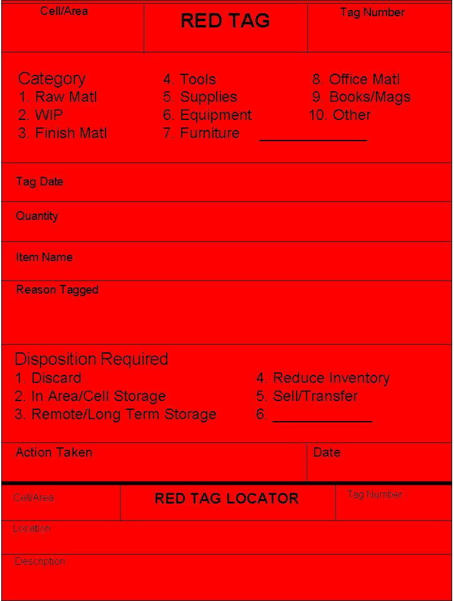
Red-Tagging
5S Process
Red Tag Template
A tracking process to provide visual identification of unneeded items
After all obvious items are discarded, the remaining items are red-tagged to assure proper disposition
Should be full size
(8.5” x 11”)
Bright red to promote visibility
Should have pre-printed sequential tag numbers
Perforated lower section to record location of tag
Notes:
SAY: “After all obvious items have been dispositioned from 1S, move on to the Red Tagging process to address those items that we are needed but not in the area.”
SAY: “The purpose of Red Tagging is to provide visual identification of unneeded items and to provide a tracking system for red-tagged items.”
DO: Explain Red Tags and Red Tag Board and how to use the lower section of the tag.
Red Tag hints:
do not be defensive - all areas get tagged
do not red tag people
one tag per item
make reasonable allowances for decorative items such as family pictures and plants.
If in doubt - GET IT OUT!

Slide 29
Red-Tagging Procedures
5S Process
Step 1
Step 2
Step 3
Step 4
Step 5
Select members from various teams
Select a high level manager to participate as a team member
Identify Red Tag targets
Inventory, equipment, supplies, tooling, space
Office areas are not exempt from red tagging
Define Red Tag criteria
Determine what criteria will used to distinguish a needed item from an unneeded item
Example: Save only the items needed to conduct business in the area
Explain red tag criteria to teams
Ensure a good cross-section of people tagging items to prevent “I might need that”
Red tag work area as rapidly as possible
Evaluate red tag items
Dispose of truly unnecessary items
Retain red tagged material if there is proper justification
Discard any material which has been red tagged after a pre-determined time
All red tags must be completed and returned to the red tag coordinator

Slide 30
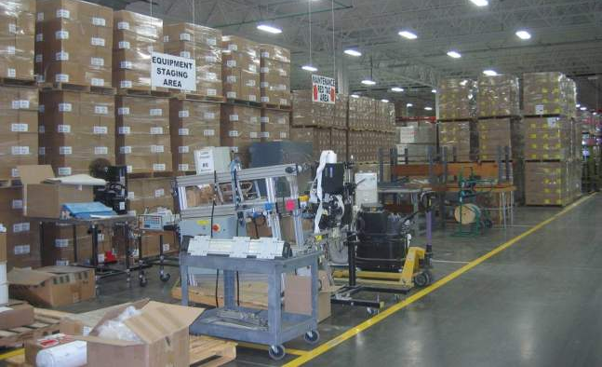
Example of a Red Tag Area
5S Process

Slide 31
Sort Strategy
5S Process
Examine the workplace
Identify truly needed items
  What is it for?
  Why do I have it?
  How often do I use it?
  Does someone else have it?
Throw away anything you know you can
Use red tagging for items that you are unsure whether or not
they are needed
Notes:
Review the key actions to simplify the workplace

Slide 32
Exercise: 1S
5S Process
Objective
Complete 1S for the business event
Instructions
Time to Complete
As a team, discuss approach to completing 1S.
Assign individual tasks.
Determine time to accomplish 1S and review
results
Deliverable
Completed 1S
Notes:
Give the team an approximate time to complete 1S.

Slide 33
5S
5S Process
1S - Sort
    2S - Straighten
3S - Scrub
4S - Stabilize
5S - Sustain

Slide 34
2S Defined
5S Process
English: STRAIGHTEN
Japanese: STRAIGHTEN
Objective
of 2S
STRAIGHTEN
Organize the necessary items so that they can be used and returned easily
SEITON
Orderliness. Focuses on the need for an orderly workplace. Tools, equipment, and materials must be systematically arranged for the easiest and most efficient access. There must be a place for everything and everything must be in its place.
Place all of the items in the best location and visually organize the area
Keep in mind:
  Proper locations
  Storage Methods
  Location Marking
  Shadow Boards
  Sign Boards
2S promotes visual management
Notes:
SAY: “Think about, and understand, how work is done in the area. Keep everything visual and easy to understand. 2S is associated with the phrase: “A place for everything, everything in its place.”
ASK: “What would happen if there were no street signs, highway or house numbers?”

Slide 35
2S Strategy
5S Process
First decide where all items should be so that the organization is easy to use and understand
Choose proper storage methods that minimize inventory and promote visual management
Visually indicate locations so items in use can be returned and missing items are easily identified
Make sign boards that clearly explain inventory, equipment, and other items so anyone can understand in the workplace
Notes:
SAY: “When performing 2S, organize the necessary items so that they can be used and returned easily.
DO: Place all necessary items in the best location and visually organize the area.
First decide where all items should be so that the organization is easy to use and understand
Choose proper storage methods that minimize inventory and promote visual management
Visually indicate locations so items is use can be returned and missing items are easily identified
Make sign boards that clearly explain inventory, equipment, and other items so anyone can understand the workplace
Straighten and Organize
Straighten follows simplify because we do not want to waste time organizing, locating and marking items that are not necessary.
Now we have only what we need to do our jobs, so that the task of organizing and cleaning is much easier.

Slide 36
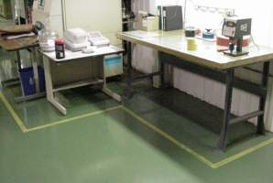
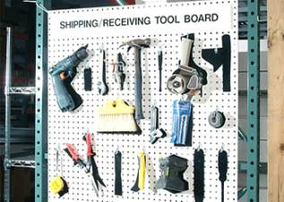
2S: A place for everything and everything in its place
5S Process
Notice the missing tools…

Slide 37
Visually Identify Critical Parts, Areas, and Items
5S Process
Standard Color Guide
 | Safety International Green | Safety Equipment, First Aid, Safety Posters, Notices
 | Quality International Blue | Inspection Points, Quality Notices and Instructions, Gauging
 | Standards Federal Safety Yellow | Operations Standards, Location Marks, New Tooling, Good Part Storage
 | Defects Federal Safety Red | Scrap, Bad Parts, Warranty Materials, Dull Tools
 | Maintenance Pure White | Repair Tools, TPM Materials, Machinery, Cleanliness
Notes:
SAY: “Identify critical items, parts, and areas within factories with common colors which provides for a common understanding for any associate or visitor.”
Proper location:
point of use location
consider human mechanics
Also:
Use 5S to minimize inventory:
parts, tools, gages, paperwork
The goal is Visual Management. Example: Driving your car, speed limit, double yellow lines, exit #’s, stop, yield signs, etc

Slide 38
Exercise: 2S
5S Process
Objective
Complete 2S for the business event
Instructions
Time to Complete
As a team, discuss approach to completing 2S.
Assign individual tasks.
Determine time to accomplish 2S and review
results
Deliverable
Completed 2S
Notes:
Give the team an approximate time to complete 2S.

Slide 39
5S
5S Process
1S - Sort
    2S - Straighten
3S - Scrub
4S - Stabilize
5S - Sustain

Slide 40
3S Defined
5S Process
English: SCRUB
Japanese: SEISO
Objective
of 3S
SCRUB
Cleaning floors, equipment, furniture in all areas of the workplace
SEISO
Cleanliness. Indicates the need to keep the workplace clean as well as neat. Cleaning in Japanese companies is a daily activity. At the end of each shift the work area is cleaned up and everything restored to its place.
Establish a clean workplace
Sweep and wash floors
Clean in, around and under all equipment and furniture
Eliminate all trash from the workplace
Ask the question:
  How do things get dirty?
Find and address root cause
3S identifies and eliminates the source of uncleanliness
Notes:
SAY: “Scrubbing implies tough, thorough cleaning; not just sweeping!”
NOTE: May do some parallel to straightening. For example, you may clean floor before you paint a line there
SAY: Insure bright lighting of all area. Areas should be cleaned by those that work there.
ASK: “How do (did) things get dirty? Look for root causes of dirt, oil, chips, etc.”

Slide 41
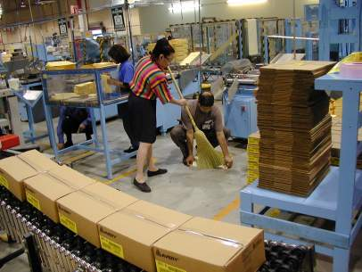
3S Strategy, continued
Allows you to quickly identify “abnormalities”
Eliminates idea of “spring cleaning”
Maintains discipline
Becomes a part of your regular, daily routine
Dedicate FIRST five minutes of each day to systemic cleaning

Slide 42
Exercise: 3S
5S Process
Objective
Complete 3S for the business event
Instructions
Time to Complete
As a team, discuss approach to completing 3S.
Assign individual tasks.
Determine time to accomplish 3S and review
results
Deliverable
Completed 3S
Notes:
Give the team an approximate time to complete 3S.

Slide 43
5S
5S Process
1S - Sort
    2S - Straighten
3S - Scrub
4S - Stabilize
5S - Sustain

Slide 44
4S Defined
5S Process
English: STABILIZE
Japanese: SEIKETSU
Objective
of 4S
STABILIZE
Maintaining and improving the standards of the first 3 S’s
SEIKETSU
Standards. Allows for control and consistency. Basic housekeeping standards apply everywhere in the facility. Everyone knows exactly what his or her responsibilities are. Housekeeping duties are part of regular work routines.
Maintain and improve the neat, organized workplace
Eliminate excess storage areas and flat surfaces
Make changes to equipment that make it easy and quick to eliminate dirt and leaks at their source
Use checklist to establish daily cleaning and organization activity
Institute 5S Patrols
4S not only maintains, but improves what has been put in place
Notes:
ASK: “Why is it important to stabilize.”
SAY: “Use 5S patrols to monitor 5S progress. What does not get measured does not get improved.”
SAY: “To keep a workplace neat and clean, you need 4S and 5S.”
SAY: “Think deeply about why we ‘slip’
Is cleaning hard and unpleasant?
Do we have time?
How can we make it easier and faster?”
ASK: “What else should we consider doing?”
Eliminate excess storage areas and flat or horizontal surfaces
Fix root causes of leaks, dirt, chips, etc.
Checklist for daily cleaning.
DO: Discuss proactive vs. reactive efforts
DO: Discuss monitoring 5S progress through 5S patrols, reports and check sheets.
Show and explain 5S patrol check sheets and reports.
Explain the use of the 5S wheel
can be located on the cell KPI board
5S levels driven by the checksheet

Slide 45
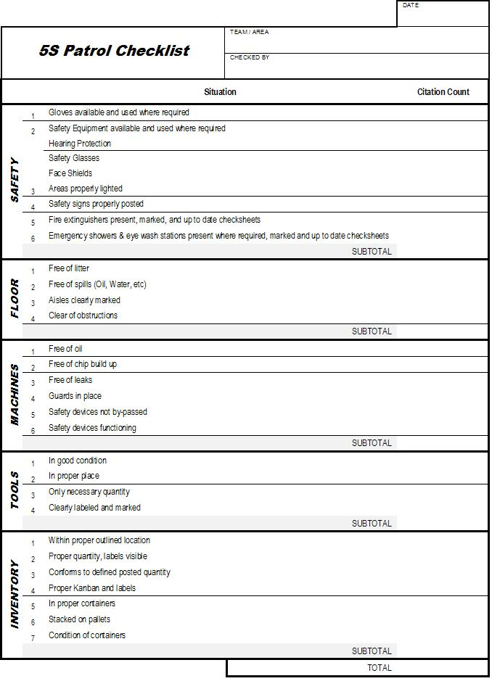
5S Patrol Checklist – Manufacturing Areas
5S Process
Develop a standard procedure for the use of this form
Use form consistently to measure results of 5S in all areas
Identify 5S Owner of each area – make no assumptions regarding ownership
Follow-up and conduct regular 5S Patrols

Slide 46
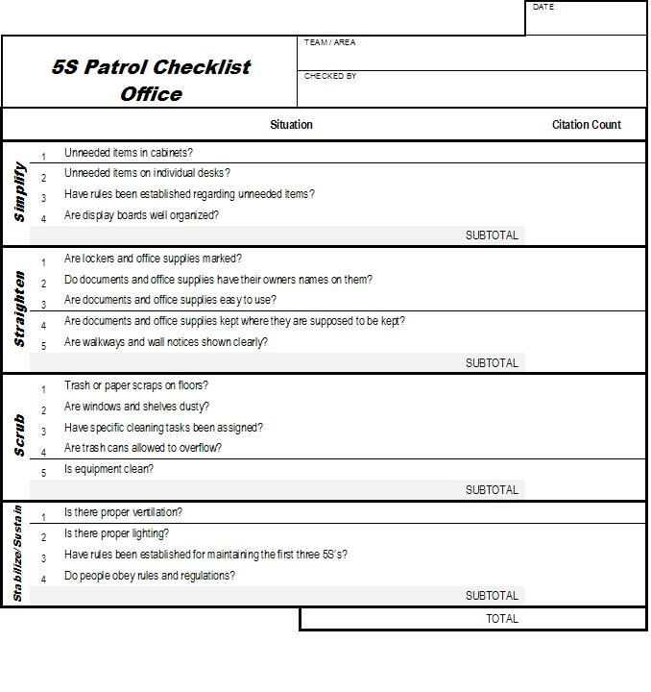
5S Patrol Checklist – Office Areas
5S Process
Office areas are not exempt from 5S
Form is a guideline – modify as appropriate for your use
If 5S event occurred for electronic/digital process – what considerations will need to be made in order to stabilize and improve the process?

Slide 47
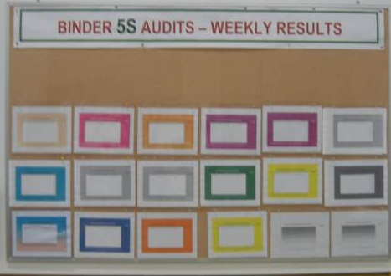
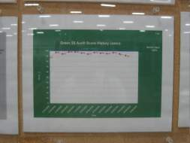
5S Audit Example
5S Process

Slide 48
Exercise: Identifying processes that need to be sustained
5S Process
Objective
Generate list of processes that need to be sustained
Instructions
Time to Complete
As a team, discuss which processes need to be
sustained from THIS event.
10 minutes
Deliverable
Generated list on chart paper

Slide 49
Exercise: 4S
5S Process
Objective
Complete plan for 4S for the business event
Instructions
Time to Complete
As a team, develop specific plan/process to
standardize and sustain the processes from the
generated list for this event.
Assign owner(s).
Deliverable
Completed 4S plan
Notes:
Give the team an approximate time to complete 4S plan.

Slide 50
5S
5S Process
1S - Sort
    2S - Straighten
3S - Scrub
4S - Stabilize
5S - Sustain

Slide 51
5S Defined
5S Process
English: SUSTAIN
Japanese: SHITSUKE
Objective
of 5S
SUSTAIN
Achieving the discipline or habit of properly maintaining the correct 5S procedures
SHITUSKE
Sustaining discipline. Refers to maintaining standards and keeping the facility in safe and efficient order day after day, year after year.
Develop a habit of sorting, straightening, scrubbing, and stabilizing your workplace
Everyone has to accept 5S as a personal goal
People follow examples (good and bad), set a good example
5S is about changing the discipline of your culture
Notes:
SAY: “A company president is walking through the plant on his way to meeting, greets the operators with a friendly greeting as he passes them, and walks right by crumpled trash on the floor. What message does that send?”
SAY (following important points):
Habit - a pattern of behavior acquired by frequent repetition
Create long term cultural change which must be preceded by behavior changes
Any system is only as good as the people using it - use an example of not “walking the talk”
Once we develop habits and 5S becomes a way of life, it’s easy to keep up
5S shows in everything you do (lead by example!)
5S can become an attitude that grows out of continuity and practice.

Slide 52
5S Strategy
5S Process
Discipline yourself to maintain 5S procedures
Proliferate 5S across entire business
Hold each other accountable for sustainability
Set high standards for yourself and good example for others
Management must lead the way
Set the standard to benchmark
Include 5S in performance reviews
Notes:
SAY: “Achieving a 5S culture requires exquisite discipline. You must be responsible and hold each other accountable to sustain results and continue to improve.”

Slide 53
5S Rules of Discipline
5S Process
Keep it simple
Make it visual
Accept feedback and give it constructively
Correct problems immediately
Drill down to root cause to address source of disorder or dirt
Energize yourself! Improvement requires effort and effort requires enthusiasm
Notes:
SAY: “Keep it simple, simple, simple…. Cannot stress this enough! And Make it visual, visual, visual! Use five-why’s and one how to address problems at root cause.”

Slide 54
Exercise: 5S
5S Process
Objective
Perform audit of the kaizen area.
Instructions
Time to Complete
As a team, review your list of wastes from 1S activity (or multiple S’s) and quantify benefits of your event success (include estimated time savings, defect reduction, computer downtime, customer perceptions, pride and personal satisfaction).
Perform objective audit using the 5S Patrol Checklist of the target area, providing very specific feedback and any further ideas for improvement.
60 minutes
Deliverable
Measurable results obtained by event and thoughtful feedback
Notes:
NOTE: Make sure everyone has a copy of the “5S Patrol Checklist.” May need to change time to complete, based upon number of teams and location of each area.
NOTE: If there is only one team on for this event, have them audit their own results.

Slide 55
5S
5S Definition
5S Process
5S Review
Objectives:
Summary of the steps of 5S
Identify common pitfalls when implementing 5S
Discuss how to avoid 5S common pitfalls
Review of key learnings
Notes:
DO: Review section objectives on slide.

Slide 56
Summary of 5S
5S Review
5S Descriptions
1S
Sort
Define what is necessary and unnecessary
2S
Straighten
A place for everything and everything in its place
3S
Scrub
Identify the sources of uncleanliness
4S
Stabilize
Execute process to maintain/improve the standards of the first 3 S’s
5S
Sustain
A sustained, disciplined 5S culture in the workplace

Slide 57
5S is Key to a Lean Business System
5S Review
Develop Strategic
Business Imperatives
Profitable Growth
Enterprise Optimization
5S
Value Stream Optimization
5S
Lean Fundamentals
Waste Elimination Tools
5S
Lean Infrastructure
Notes:
SAY: “A Lean Business System represents the methodology and approach used to Implement and Deploy Lean into an Organization.”
SAY: “LEAN” is simply the elimination of waste. 5S is a MUST. It is related to every improvement process you will embark upon. As you have seen this week, LACK of 5S CREATES waste, and implementation of 5S “reveals” the true process, enabling further improvement. 5S is a foundational tool in a lean organization. It creates the discipline needed to improve and sustain results.
NOTE: The Strategic Business Imperatives guide all lean efforts and activities which is why this is shown at the top. We then work our way up to fulfilling our strategy by deploying lean in this sequence.

Slide 58
What are common pitfalls with 5S you have seen or foresee?
5S Review
Lack of assessment procedures
Perception that 5S is a “shop-floor only” tool
Perception is that 5S is about “cleaning”
Perception that this is a 1-time event… not a continuous process
5S not seen as a management tool
5S viewed as somebody else’s responsibility
5S viewed as “simple” and that everyone “knows how to do it”
Notes:
SAY: This is a foundational improvement tool that has more to do with Safety, Visual Management and Productivity than housekeeping. Success with 5S must occur before sustained results with other tools can be applied.

Slide 59
Exercise: How to avoid common pitfalls
5S Review
Objective
Discuss methods to avoid the common 5S pitfalls
Instructions
Time to Complete
In small groups, discuss each of the 5S pitfalls.
Determine what actions could be taken, or what
could be done to avoid the common pitfalls.
Chart ideas on chart paper.
10 minutes
Deliverable
Report-out on ideas for avoiding pitfalls
Notes:
POTENTIAL ANSWERS:
Tie 5S events to key business imperatives
Support the participation of all associates on 5S events
Establish 5S “Owners” at the end of each event accountable for the monitoring of the 5S areas
Management should perform 5S audits and provide feedback
Management should communicate the benefits of 5S and model the desired behavior
5S Events should be held in non-operations areas
Event results should be shared and communicated
Testimonials about improved safety and workplace morale as a result of the 5S event should be communicated.

Slide 60
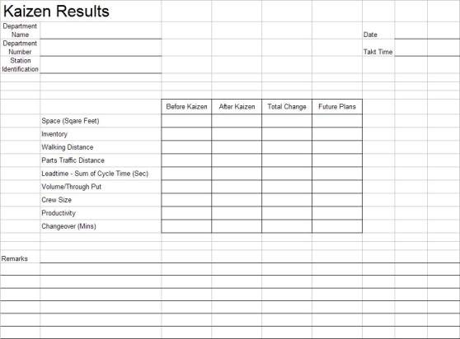
Kaizen Results
5S Review
Notes:
SAY: “Here is a form we recommend you use to track the kaizen results. This makes it easier to have a visual of the improvements made to date and the opportunities that still exist.”
NOTE: This form is in excel and additional measurements could be added per the event objectives.

Slide 61
Prepare for Final Report-Out to Management
5S Review
All team members should contribute to the final report-out presentation to management
Report-out should include
  Introduction of Team
  Review of Event goals and objectives
  Review of Former Process and Documentation Forms
  Review of Improvement Opportunities Identified and Implemented
  Review of Documentation and Kaizen Results Form
  Review of Kaizen Newspaper
Typical Report-Out times are 15 minutes for presentation and 15 minutes for questions
Notes:
DO: Cover report-out guidelines.

Slide 62
Exercise: 5S Event Wrap-Up
5S Review
Objective
Document event results and record lessons learned.
Instructions
Time to Complete
Each team photograph all “after” areas
Post 4S Checklist and 5S Audit Sheet in area
Record top 3-5 lessons learned on chart paper
Celebrate!
60 minutes
Deliverable
Invite others for report-out of results and a tour of “new” areas

Slide 63
Summary of 5S
5S Review
5S is a foundation for improvement
Visual Management is the ultimate goal
It is up to each and every one of us to make 5S a personal goal
Notes:
DO: Summarize the importance of 5S and ask participants to describe what they can do right now (when they return to their workplace) to begin to implement a 5S program.

Slide 64
Other Modules In This Series:
5S
Standard Work
Total Productive Maintenance (TPM)
Administrative Lean
Cell Design/ Production Preparation Process (3P)
Kaizen
Kanban
Problem Solving
Poka Yoke Quality Systems
Transaction Process Improvement (TPI)
Cause & Effect Diagram with the Additions of Cards (CEDAC)
Single Minute Exchange of Dies (SMED)
Value Stream Mapping (VSMi®)
Visual Management
Managing Daily Process Excellence
For More Information Please Contact:
Mark DeLuzio, President and CEO
+1.860.234.0915
mark.deluzio@leanhorizons.com
Strategically Creating Value Through the Elimination of Waste

